Slide 1

🎧 Mood Awakening Jukebox 🤖 AI-Based Emotion Driven Music . . Recommendation System Submitted by: Ashwin Daniel . g Technology: Artificial Intelligence & . . Machine Learning

Slide 2

Introduction:
🎵 Music plays an important role in influencing human emotions.
😕 People often find it difficult to select music that matches their current mood.
🤖 With the help of Artificial Intelligence, music selection can be
automated.
👉 This project introduces a smart jukebox that detects user emotion and plays suitable music automatically.

Slide 3

Problem Statement
❌ Manual music selection is time-consuming
❌ Mood changes frequently
❌ Existing music apps depend on user choice
❌ Users may not know what music suits their mood
🎯 Need: An intelligent system that understands human emotion and suggests music accordingly.

Slide 4
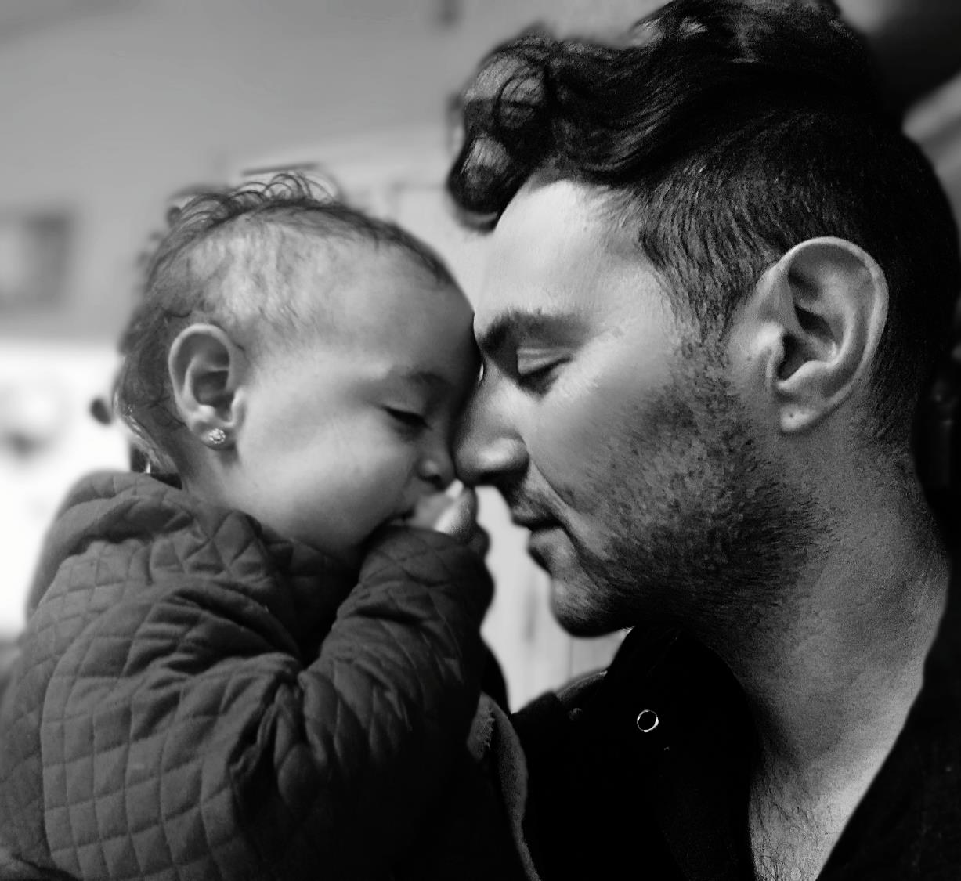
Objectives of the Project
🎯 Detect user emotion using facial image 🎯 Classify emotion into music mood 🎯 Automatically select and play songs 🎯 Provide simple and interactive user interface 🎯 Improve user music experience using AI

Slide 5


Proposed Solution
💡 The system captures a selfie from the user
😃 Facial emotion is detected using DeepFace
🎵 Emotion is mapped to a suitable music mood
🎧 Songs are selected from dataset automatically
✔ No manual search required
✔ Fully automated music recommendation

Slide 6

Technologies Used
🧑‍💻 Programming Language
Python 🐍
🧠 AI & ML Libraries
DeepFace (Emotion Detection) 😃
Random Forest Classifier 🌲
🎵 Audio Processing
Librosa
SoundFile
🖥️ User Interface
Gradio
📂 Dataset
GTZAN Music Dataset

Slide 7

System Architecture
🏗️ Architecture Flow
📸 User Selfie ⬇️ 😃 Emotion Detection (DeepFace) ⬇️ 🎭 Emotion → Mood Mapping ⬇️ 🎵 Music Genre Selection ⬇️ 🔊 Audio Playback (Gradio UI)

Slide 8

System Workflow
🔁 Step-by-Step Process
1️⃣ User uploads selfie 2️⃣ System detects facial emotion 3️⃣ Emotion converted into music . . mood 4️⃣ Songs fetched from dataset 5️⃣ Music starts playing 6️⃣ User can change songs using . . buttons

Slide 9
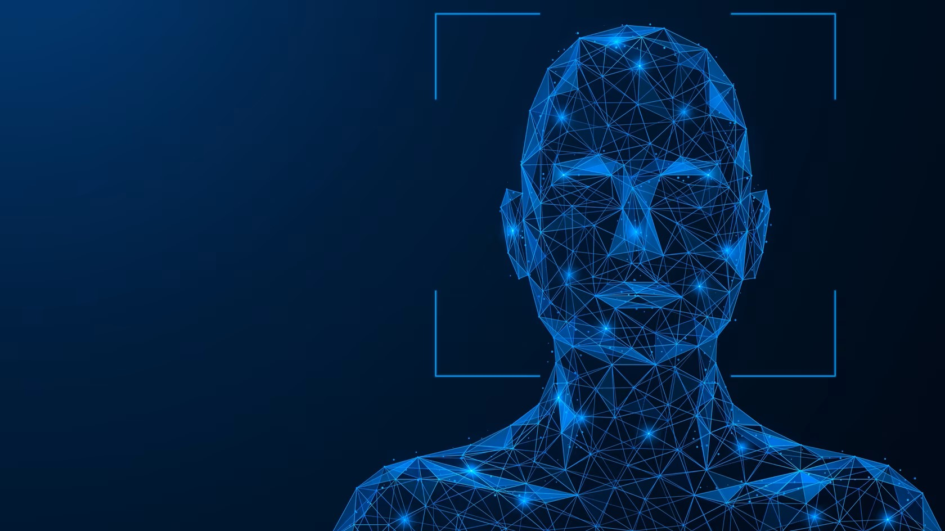
Emotion Detection Module
😃 Facial emotion detection is done using DeepFace 📊 Detects emotions such as:
Happy
Sad
Angry
Neutral
🎭 These emotions are grouped into broader music moods like:
Happy
Calm
Sad
Energetic

Slide 10
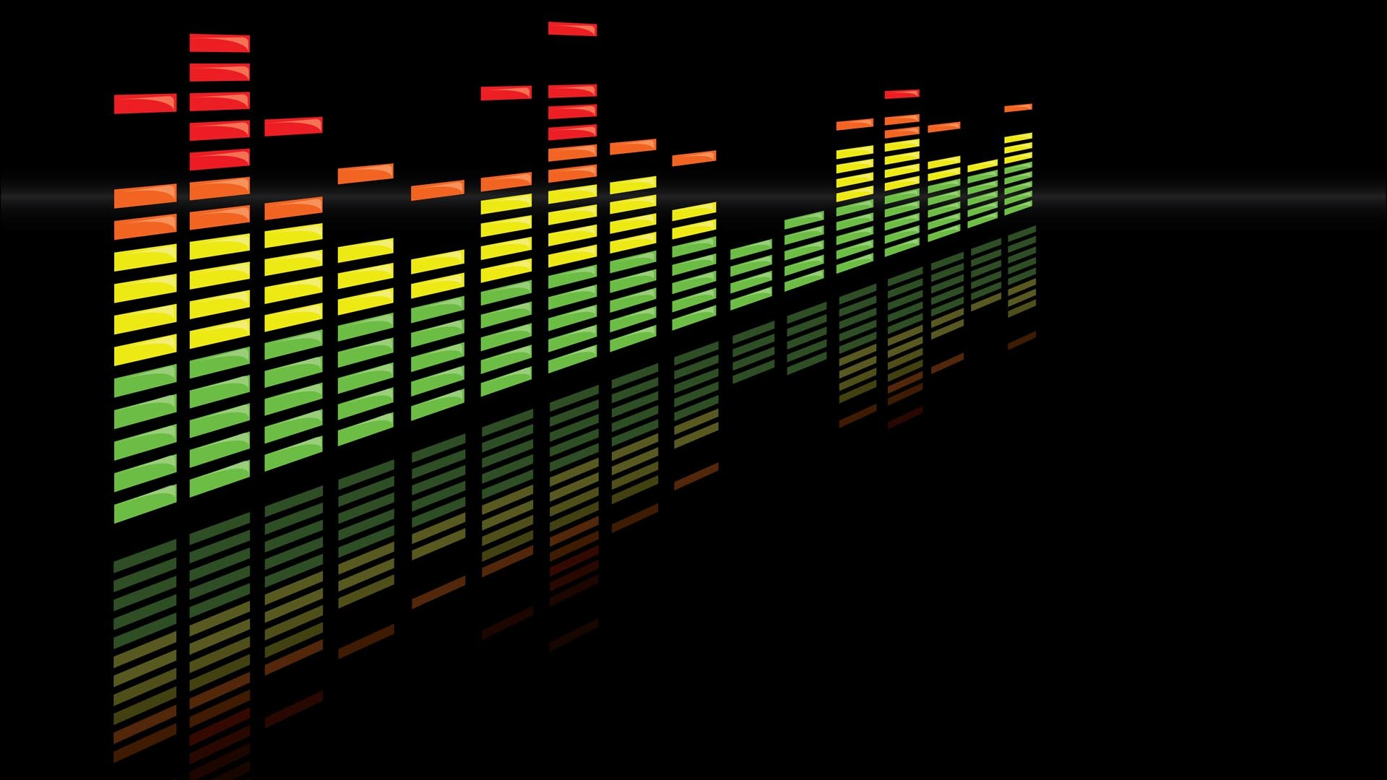
Music Processing Module
🎶 GTZAN dataset is used for music files 📈 Audio features extracted using MFCC 🧠 Random Forest model is trained using features
📌 Currently used for future extension 📌 Can be used for audio-only mood detection

Slide 11

Mood Mapping Logic
🎭 Emotion → Mood → Genre
😃 Happy → Pop, Disco, Reggae
😢 Sad → Blues, Classical
⚡ Energetic → Rock, Metal, Hip-Hop
😌 Calm → Jazz, Country
🎵 Songs are shuffled randomly for variety

Slide 12


User Interface
🖥️ Built using Gradio Web Interface
📷 Upload selfie option 🎧 Audio player ⏮️ Previous button ⏭️ Next button 📝 Displays:
Detected Mood
Song Name
✔ Simple ✔ User-friendly

Slide 13


✅ Automatic mood detection
✅ Personalized music experience
✅ Saves time
✅ Easy to use
✅ Combines AI, ML & Audio Processing

Slide 14


🎵 Music Recommendation Systems
🧠 Mental Health & Wellness Apps
🏠 Smart Home Entertainment
📱 AI-based Media Applications
🚗 In-car music systems

Slide 15

Future Enhancements
🚀 Real-time webcam emotion detection
🎧 Spotify / online music integration
📈 Improve ML model accuracy
📱 Mobile application development
🧠 Pure audio-based mood prediction

Slide 16

Conclusion
🎯 The Mood Awakening Jukebox demonstrates the use of AI to understand human emotions.
🎵 It provides automatic and personalized music recommendations.
🤖 This project shows effective integration of:
Computer Vision
Machine Learning
Audio Signal Processing
✔ Enhances user experience ✔ Practical real-world application

Slide 17
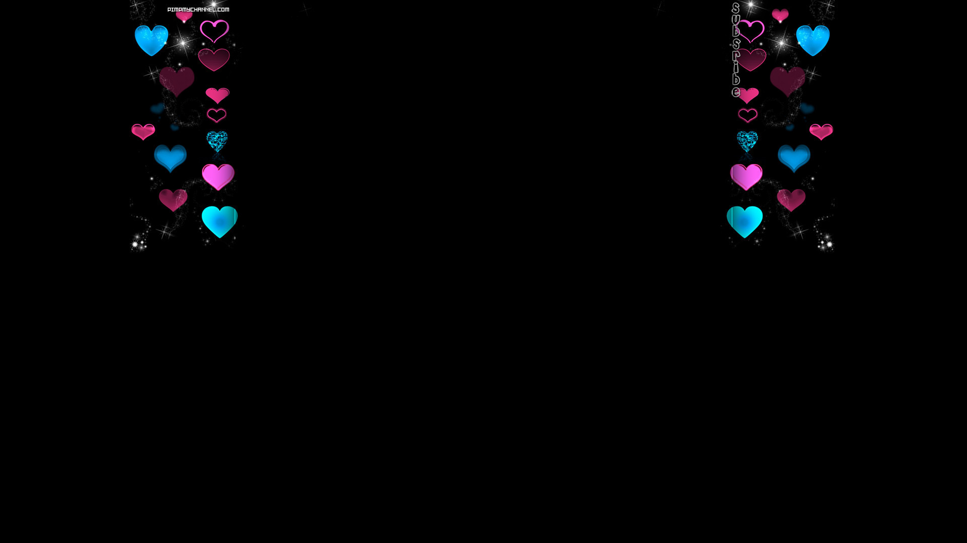
🙏 Thank You 🎧 Let the music match your mood

